Slide 1

Mobile Automation
With

Slide 2
Introduction
What is Appium?
Why Appium?
Notes:
Appium is an open source tool for automating native, mobile web & hybrid applications on iOS & Android platforms.
Now that we know what is Appium. Let’s understand why to use Appium tool. To answer this, let’s first see how Appium is compared with other popular mobile test automation tools.

Slide 3
Appium vs other testing tools
 | Appium | UiAutomator | Robotium | Calabash | Espresso
Android | ✅ | ✅ | ✅ | ✅ | ✅
iOS | ✅ | ❌ | ❌ | ✅ | ❌
Mobile Web | ✅ | ✅ | ✅ (Android) | ✅ | ❌
Real Device Support? | ✅ | ✅ | ✅ | ✅ | ✅
Simulator/ Emulator Support? | ✅ | ✅ | ✅ | ✅ | ✅
Language Supported | Many | Java | Java | Ruby | Java
Notes:
Not all popular mobile automation tools are cross platform.
Though UIAutomotor & Espresso is backed by Google but they only support Android platform.
Same is the case with Robotium.
Appium & Calabash both support Android & iOS. But Calabash only supports one programming language which is Ruby.
There is no such limitations with Appium. For Appium you can write test cases in almost any language.
Appium also enjoys wide community support which something Calabash lacks.

Slide 4
Appium Advantages
Cross Platform support
Multi Language support
Common API
No need to recompile app
Notes:
Common API (Webdriver API) : One of the major advantage is that it has common API library for all platforms it supports. What it means is the same code you write for Android APP will work for iOS APP as long as APP implementation is same.
No need to recompile your APP: Another major advantage is that you don’t need compile your APP to automate it or root your device or add any library or framework to your APP source code.

Slide 5
Appium Design
Cross platform Support & No need to recompile app
By using vendor-provided automation frameworks
iOS - Apple’s UiAutomation
Android 4.2+ - Google’s UiAutomator
Android 2.3+ - Google’s Instrumentation
Multi Languages Support
By wrapping the vendor provided frameworks in one API i.e the WebDriver API
WebDriver specifies a client-server protocol (known as the JSON Wire Protocol)
Notes:
How does Appium manage to provide all these features. To answer this we need understand Appium Design.
Uses Apple’s UIAutomation & Google’s UiAutomator testing framework to automate APP of the respective platform.
Meets multi language support by wrapping the vendor-provided frameworks in one API i.e the WebDriver API.
WebDriver specifies a client-server protocol (known as the JSON Wire Protocol).
Client written in any language can be used to send appropriate HTTP request to the server.

Slide 6
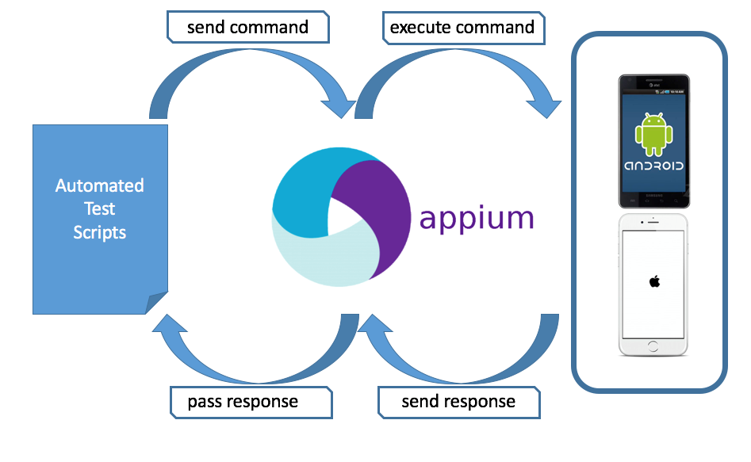
Appium Architecture
Notes:
Appium Architecture (3 main components)
Appium server is written in Node.js.
Client Libraries are Appium extension to the WebDriver protocol. Examples : Java, Ruby, PHP and many more.
Native Test Libraries are test automation framework provided by Android & iOS.
Receives connection from a client, listens for a command, executes those commands on a mobile device and responds with HTTP response representing the command execution.

Slide 7
Are there any limitations?
Only supports Android 4.2+ (API>=16)
Mac OSX 10.7+ is required. Lower OS version is not supported
Gesture support is limited
Notes:
Appium is certainly not perfect.
Inspite of its limitations I believe its the best mobile automation tool in the market and it is getting better with every release.

